Slide 1

SHE: Safety, Health and Environment
Sello Malomane

Slide 2
Western Region SHE Seminar
Dr Pat Mazibuko
Sello Malomane
Nombeko Ntsadu
Lucas Ndala - COO

Slide 3

SHE Behaviour cycle
Participation
Understanding
Commitment

Slide 4
Labour Acts of South Africa (not limited to)
Basic Conditions of Employment (Act No. 75 of 1997)
Employment Equity Act, 1998 (Act No. 55 of 1998)
Labour Relations Act, 1995 (Act No. 66 of 1995)
Skills Development Act, 1998 (Act No. 97 of 1998
Occupational Health and Safety Act, 1993 (Act No. 85 of 1993)

Slide 5
Employer’s duties
OHSA (Occupational Health and Safety Act 85 of 1993, Section 8)
It's the duty of the employer to provide and maintain a working environment that is safe and without risk to the health and safety of employees
Safe is free from danger
Compiled by Openserve Marketing

Slide 6
Employer’s duties
Identify the hazards in the workplace.
Evaluate the risks.
Do whatever needs to be done to protect the worker from injury or health problems.
If anything is unsafe, your employer must take action to make it safe.
The employer must train the workers properly.
The employer must make sure the workers obey safety rules and the law.
Ensure SHE structures are implemented and health and safety representatives are appointed.
Compiled by Openserve Marketing

Slide 7
“Safety starts with me……”
But … (Occupational Health and Safety Act 85 of 1993, Section 14)
YOU are responsible for your own safety
Not obeying the safety rules may result in serious injury, ill health or death

Slide 8
Employee duties
Take care of the health and safety of themselves and of other persons who may be affected by their actions .
Bring to the attention of their employer any unsafe acts or conditions.
Carry out any lawful instructions issued by the employer in the interest of health and safety.
Report any incident on duty to the employer as soon as possible.
Compiled by Openserve Marketing

Slide 9

SHE legal structures
Health and Safety:
CEO – 16.1 appointee
Senior Management – 16.2 appointees
Chairperson – Health and Safety committee
Employer nominees
Health and Safety representatives
Co-opted
Emergency Planning:
Emergency coordinator – Emergency planning committee
Evacuation officer
Fire marshal
First aider

Slide 10
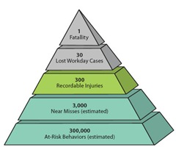
Health and Safety pyramid
Fatality
Lost workday cases
Recordable injuries
Near misses
Unsafe acts
‘SAFETY BEGINS WITH YOU and ME’

Slide 11
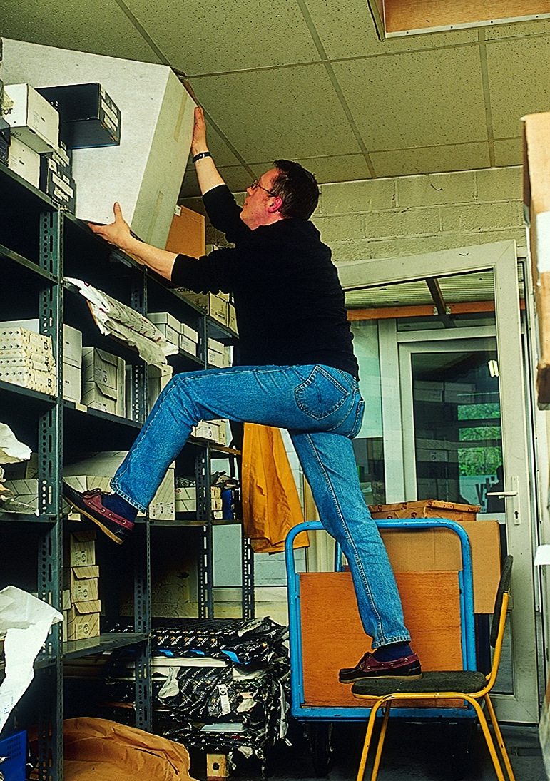
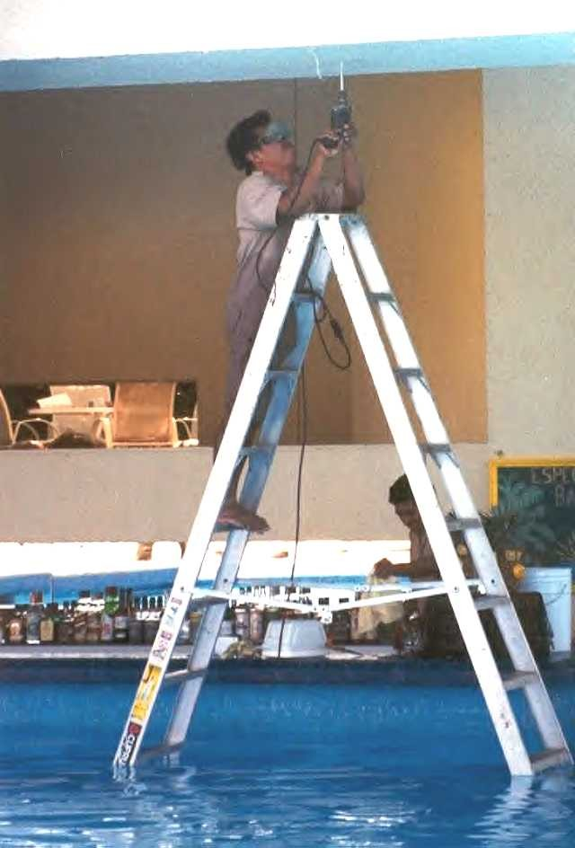
Incident causes
±88% of incidents are caused by unsafe acts
±10% of incidents are caused by unsafe conditions
±2% of incidents are caused by natural events

Slide 12

Unsafe conditions
Unguarded machines
Poor housekeeping
Poor lighting
Wet floors
Noise
Areas where there are vehicles and people
Congested areas (people and equipment)

Slide 13

Iceberg effect
Fatalities
Lost Time Injuries
Medical Treatment
First-Aid Cases
Unsafe Acts/At-Risk Behaviours
Not following rules or procedures
Taking shortcuts
Hurrying
Using poor judgement
Not maintaining good housekeeping
Awkward/uncomfortable positions
Repetitive motions
Heavy and bulky loads
Poor equipment arrangement
Poorly designed/maintained equipment
High vibration/loud noise
Glare/inadequate light
Many Close Calls with Only Minor Injury Potential
Incidents with Potential for Serious Injury

Slide 14
Housekeeping – A place for everything and everything in its place.
Work areas kept neat and tidy
No clutter
Spill it – clean it up
No obstruction of walkways and passages
Cabling neat and tidy
No overloading of electrical points
No eating at workstations
Waste to be managed accordingly

Slide 15
10 golden safety tips
Protect yourself at all times
Look out for your colleagues
All accidents are preventable
Follow company rules policies and procedures
Asses the risk … stop and think
Be proactive about safety
If you not trained …. Don’t do it
Don’t take short cuts
Practice good housekeeping, a place for everything and everything in its place.
Be prepared

Slide 16




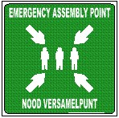


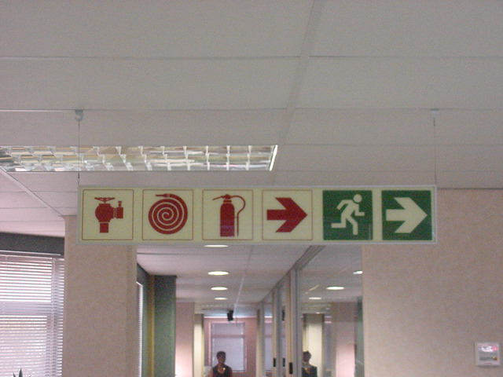





Symbolic safety signage
General information
Fire information
Warning information
Prohibitory
Mandatory

Slide 17

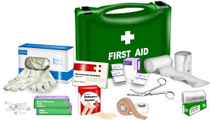

Workplace first aid
Certified first aiders are available to manage minor incidents
First aid kits are available
First aiders mandate – manage minor injuries, stabilise casualty and request emergency management services if required

Slide 18
Workplace injuries on duty (IOD)
Responsibilities:
Report all injuries to your promoter as soon as possible after the incident
Inform the SHE specialist, Health and Safety Representative and SHE committee responsible for your workplace, who will investigate the incident to determine the root cause, including identifying and implementing preventative measures and corrective actions
Inform the ‘HR Services: IOD’ section as contained on Outlook email
Complete all required documentation as contained on the SHE Management website
Ensure prompt response with all documentation requirements to ensure close out of incidents

Slide 19

Emergency management
Types of emergency situations:
Fire
Unrest / riots
Floods
Tornadoes
Chemical spills
Toxic gas releases
Radiological accidents
Bomb Threats & Explosions
Civil Disturbances
Workplace violence resulting in bodily harm and trauma

Slide 20
Section 38 – Offences, penalties, and special orders of court
Any person who - (a) contravenes or fails to comply with a provision of section 7, 8, 9, 10(1), (2) or (3), 12, 13, 14, 15, 16(1) or (2) 17 (1), (2) or (5), 18, (3), 19(1), 20(2), or or (4) , 22, 23, 24(1) or (2), 25, 26, 29(3), 30(2) or (6), 34 or 36; (f) refuses or fails to comply to the best of his ability with any requirement of a section (g) refuses or fails to answer to the best of his ability any question which an inspector in the performance of his functions has put to him; (h) willfully furnishes to an inspector information which is false or misleading; (k) having been called under section 32 without sufficient cause (the onus of proof whereof shall rest upon him) - (iv) refuses to comply with a requirement to produce a book, document or a thing specified in the subpoena or which he has with him; (2) Any employer who does or omits to do an act, thereby causing any person to be injured at a workplace, or , in the case of a person employed by him, to be injured at any place in the course of his employment or any user who does or omits to do an act in connection with the use of plant or machinery , thereby causing any person to be injured, shall be guilty of an offence if that employer or user as the case may be, would in respect of that act or omission have been guilty of an offence of culpable homicide, had that act or omission caused the dearth of the said person, irrespective of whether or not the injury could have led to the dearth of such person and on conviction be liable to a fine not exceeding R100 000 or to imprisonment for a period not exceeding two years or both such fine and such imprisonment.

Slide 21
Thank you

